Slide 1
Economics & Politics of Regulation
ECON 3385
Economics of Energy

Slide 2
Micro Refresher:
Theory of the Firm
Firms aim to maximize their profits.
Economic profit (total revenue-total economic cost) is not the same as business profit (total revenue-total accounting cost).
Total cost includes fixed costs and variable costs.
Profit Maximization Rule: MR=MC.

Slide 3
Theory of the Firm
Competitive Firm
$
MC
ATC
AVC
M
P
P=AR=MR
B
C
N
S
Qmax
Output

Slide 4
Theory of the Firm
Long-run equilibrium in a Competitive Market
$
LRMC
LRAC
P
P=AR=MR
Q
Output

Slide 5
Theory of the Firm
Imperfect Competition: oligopoly & monopolistic competition
Market power is derived from:
number of producers
relative size
barriers to entry
availability of substitutes

Slide 6
Theory of the Firm
Profit Maximization under Monopoly
$
A
P
MC
B
ATC
C
AVC
Demand
MR
Q
Output

Slide 7
Market Failure
Market failure refers to situations where the market generates less than perfect (suboptimal) outcomes from the point of view of the society.
Sources of market failure are:
Public goods
Externalities
Market Power
Equity

Slide 8
Market Failure
Market failure leads to government intervention which can take the form of social regulation or economic regulation.
Social regulation is concerned with such issues as workplace safety, health, environmental protection…
Economic regulation is more directly focused on prices, production and entry-exit conditions.

Slide 9
Competition vs Monopoly
P
Consumer Surplus:
AXP* (competition)
AFP^{m} (monopoly)
Producer Surplus:
P*XC (competition)
P^{m}FHC (monopoly)
A
S = MC for industry
F
P^{m}
X
P*
P’
H
C
D
Deadweight Loss: FXH
Q
O
Q^{m}
Q*
Notes:
COQ*X = total cost of production
AOQ*X = consumer willingness-to-pay (“w-to-p”)
P*OQ*X = what consumers actually pay = total revenue to firm
P*AX = consumer surplus (total w-to-p less actual payment)
P*CX = producer surplus
ACX = total surplus
FHX = “dead weight loss” = efficiency loss = social cost of monopoly

Slide 10
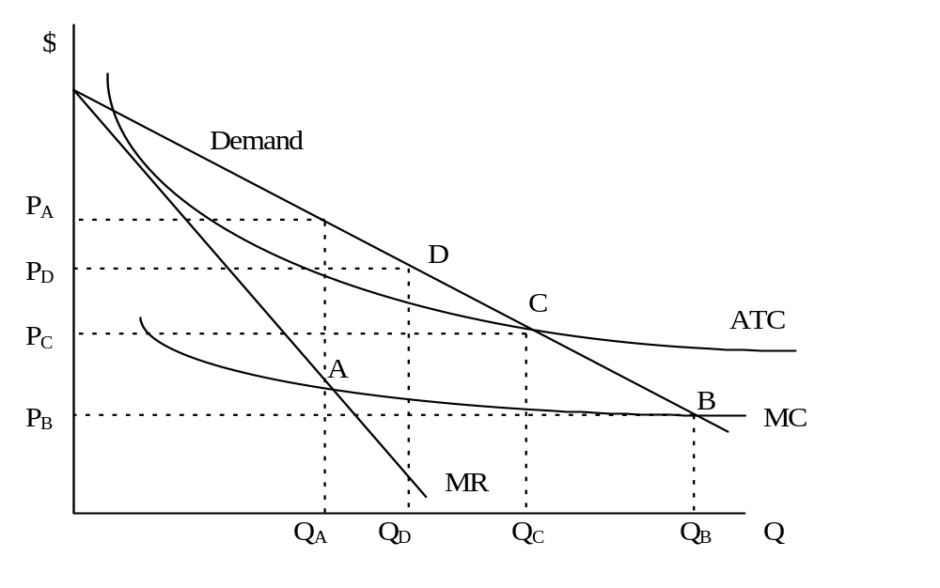
Market Failure -
Natural Monopoly

Slide 11
Possible Solutions
A, natural monopoly outcome, is what we want to avoid
B (P=MC) is equivalent to perfect competition, but negative profits
C yields zero economic profit ➔ no incentive to maintain service quality
D provides a positive return: cost-of-service (or, rate-of-return regulation)

Slide 12
Why Does Deregulation Happen?
Profit incentive for new firms to enter the marketplace
Technology drives industry economics drives policy
  New technologies facilitate the rise of competition
“Contestability” and the limits to monopoly
  The threat of “potential competition”

Slide 13
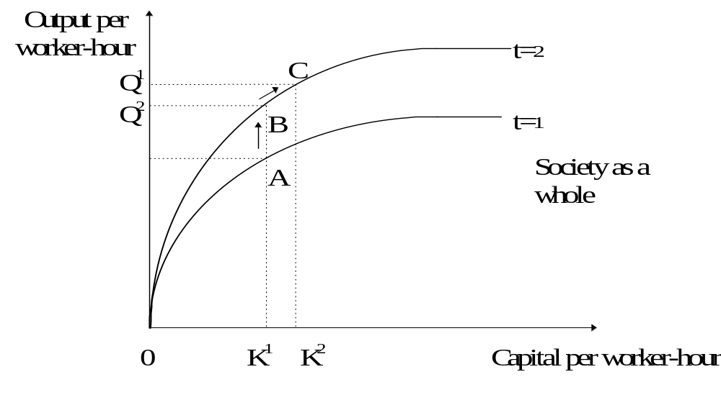
Technical Change Shifts the Production Function
Technology Industry Economics Policy
Notes:
A B= effect of technology change
B C= effect of an increase only in capital per worker-hour
A B > B C
Importance of new products, R&D
Is some monopoly power necessary to provide incentives for R&D?

Slide 14
Oil Industry
From the early days, regulated by TRRC, Interstate Oil Compact, etc.
In the 1970s, price caps
Small Refiner Bias
Subsidies for Gasohol (Ethanol)

Slide 15
Price Caps ➔ Excess D
S78
$
S70
P78*
Price cap
P70*
D78
D70
Qs
Q78*
Q70*
Qd
Q

Slide 16
Small Refiner Bias
Emergency Petroleum Allocation Act of 1973: refineries <175,000 b/d received extra entitlements
In the first two years, 11 out of 14 new refineries had < 30,000 b/d as compared to previous years when average refinery was much larger
The program failed, because:
  Market needed refineries with >200,000 b/d
  Smaller refineries used older technology that yielded more of the less valuable heavy products

Slide 17
Gasohol
Energy Tax Act of 1978: 4 cents tax exemption
In 1979, $19 billion for development and promotion of alternative fuels
Continues to receive 5.4-cent discount out of 18.4-cent gasoline tax, costing the government $7 billion in revenues since 1979
Still, less than 1% of fuel consumption and limited to Cornbelt states because of distribution problems

Slide 18
U.S. Natural Gas Industry Restructuring
Federal Regulation of Wellhead Prices
(Phillips Decision ‘54)
Federal Regulation of Interstate
Transportation (PUHCA/FPA ‘35)
Decontrol of Wellhead
Prices (NGPA ‘78)
Development of Interstate
Transportation
First Stage Open Access
for Pipelines (Order 436 ‘85)
State Public Utility Regulatory
Commissions, 1800s-1927
Final Stage of Open Access
(Order 636 ‘92)
Competitive LDC Industry
LDC Unbundling Era?

Slide 19
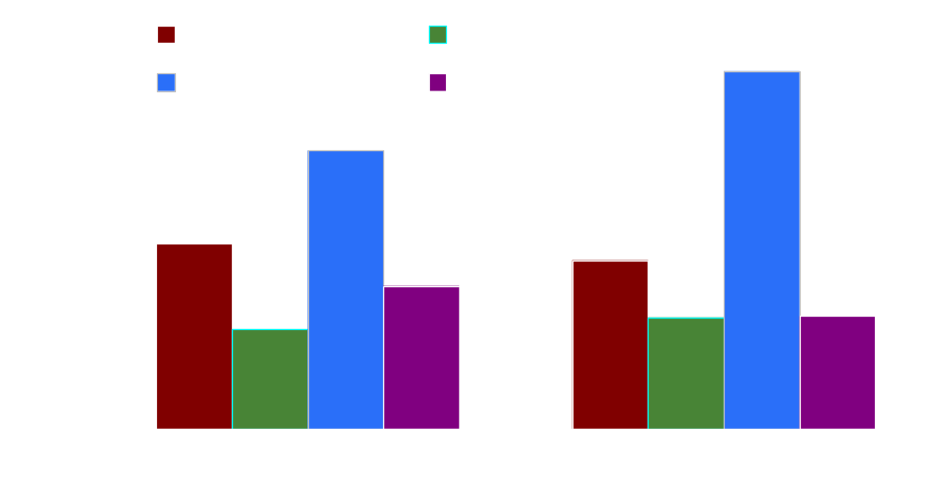
Gas Demand by Segment
Gas consumption by customer group
Source: U.S. EIA

Slide 20
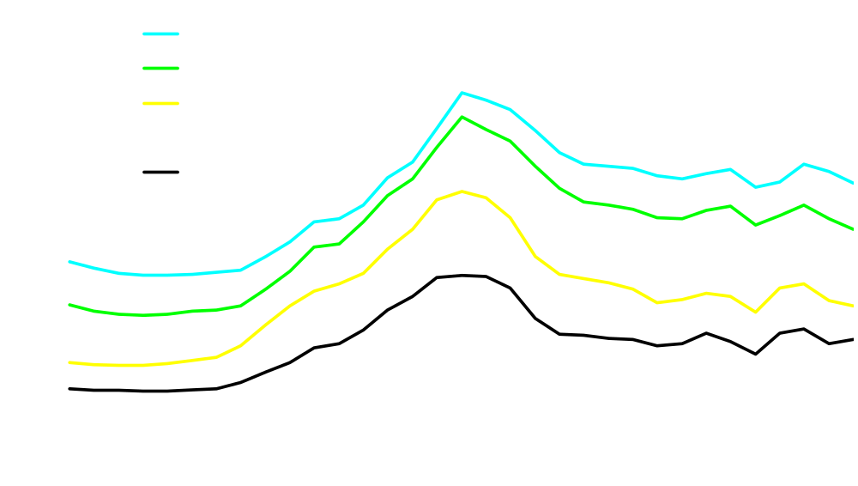
U.S. Natural Gas Prices (Real)
Source: U.S. EIA

Slide 21
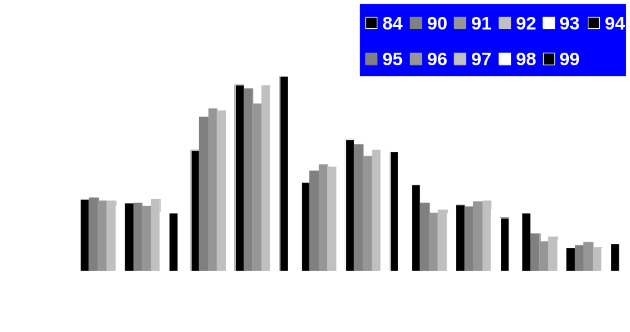
U.S. Value Chain Issues
Price differentials, $/mcf
Source: U.S. EIA

Slide 22
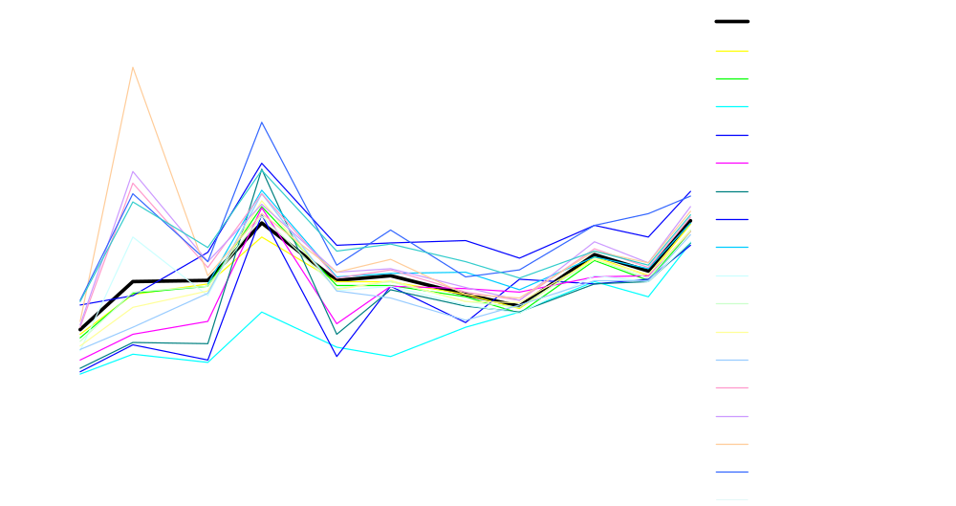
U.S. Gas Price Convergence

Slide 23
The Future of Gas?
Are we in a “new era” of $4-5/MMBtu?
Pipelines are under construction
Several LNG terminals are proposed and couple of old ones are in rehab
Is it still fuel of choice for power plants?
New areas to explore in North America?

Slide 24
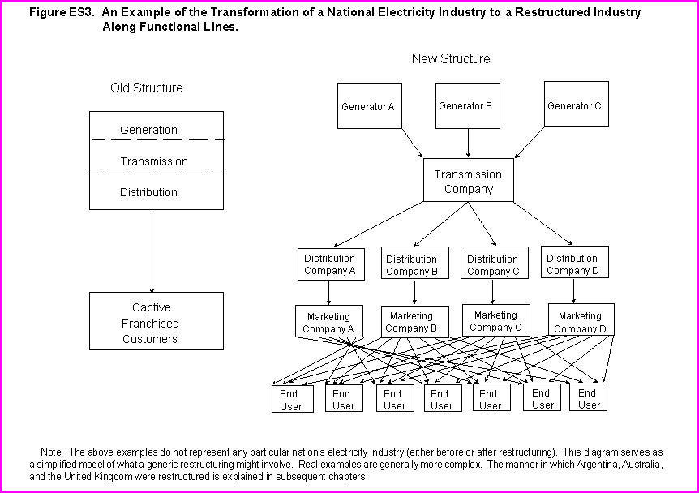
Restructuring of Electricity Industry
ISO
Gridco
Transco
Pool /
Exchange

Slide 25
Old System
Vertically integrated because of economies of scale
Regulated (or national) monopoly
Cost-of-service (rate-of-return) regulation
New System
Unbundled because competitive efficiencies in supply & retail are expected to surpass benefits of VI
T&D remain natural monopolies with regulated open access

Slide 26
Remaining Regulation
T&D is regulated natural monopoly
  In the US, cost-of-service regulation will be used:
    T (or D) tariff = cost (fixed + variable) + “fair” rate of return
  In the UK, Australia, Argentina, and so on, they use RPI-X regulation:
    Tariff at year t+1 = tariff at year t + RPI – X + K
    RPI is an inflation index; X is a measure of productivity; and K is exogenous cost
    Every few years, X is revised by the regulator
See the link “International Examples” for details.

Slide 27
Electricity Pools
Most places adopted a pool system after the UK model
  Day-ahead, hourly (or, half-hourly) blocks
  Pool operator has demand forecast for each block
  Generators bid into the pool for each block
    Amount of electricity
    The price
  Pool operator dispatches electricity from the cheapest in each block until demand is met (this is known as “merit order” dispatch)
  The price of the last unit dispatched is established as the market price

Slide 28
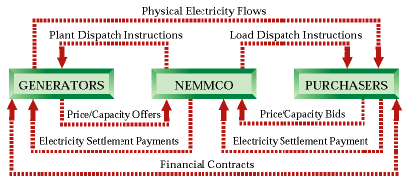
Australian Pool
www.nemmco.com.au

Slide 29
Application of Principles: Electricity Restructuring
North American Reliability Council, ‘68
Federal Regulation of Wholesale
and Interstate Commerce
(PUHCA,FPA ‘35)
Conflicts on Natural Gas
Use (PIFUA & PURPA ‘78)
Development of Interstate
Transmission
Commitment to Bulk Market
Competition (EPAct ‘92)
Samuel Insull and state
regulation, early 1900s
Open Access Begins (CPUC
‘94, Orders 888/889 ‘96)
Early Electric Utilities
Retail Wheeling Era?
Guide to Electric Power in Texas link!

Slide 30
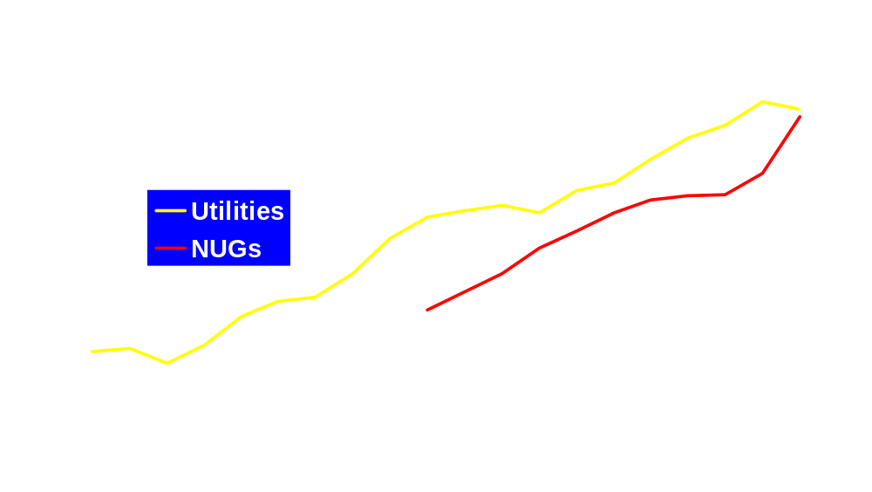
Why Restructure:
Role of NUGs
1999 electricity prices:
Residential = $0.082/kwh
Commercial = $0.072/kwh
Industrial = $0.044/kwh
Nonutility generation = 13% of total industry
Approx. 30% located in Texas
Source: U.S. EIA

Slide 31
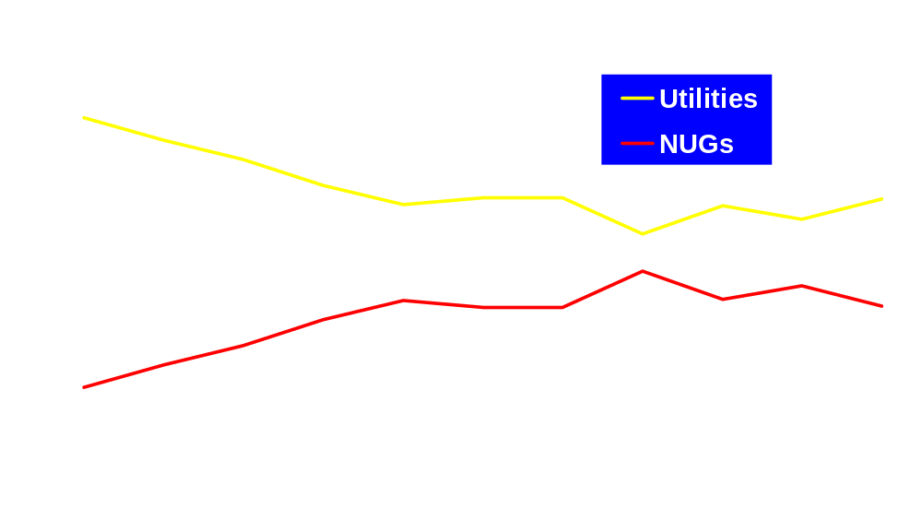
Why Restructure:
Role of NUGs
New generation capacity is increasingly
built by NUGs who use gas almost exclusively,
but turbine efficiencies may hold down gas use.
Source: U.S. EIA

Slide 32
U.S. Restructuring: Gas vs. Electricity
Natural gas was both a driver for, and set a precedent for electricity restructuring
  Increasing integration is the “logic driver” for electric restructuring
Gas can be stored, electricity cannot (yet)
Gas is cheapest when used directly
  For electricity, fuel cost of gas is higher -- but capital cost, O&M are less -- than coal or nuclear, thus far
Seasonal/daily demand, balancing, reliability are challenges for both

Slide 33
Issues for Electricity
Restructuring in the U.S.
Size and complexity of U.S. market
Market design -- How? Who?
Individual state approaches vs. federal interstate commerce
T&D constraints and development
  Generation capacity installed at load sites
Permitting and siting for generation, T&D
Reliability of service and system ➔…

Slide 34
Market Design: What Is the Role of Regulation?
Can regulators act as “market facilitators”?
Can regulators design markets? Should the U.S. have regional regulatory authorities (“how many regulators do we need?”)
Is harmonization good or bad?
Should there be a “uniform code” for North America?
Notes:
Big issues:
Regulation and sovereignty.
Why so many parallels between CUS? driver is Canadian exports.
Uniform code cannot accommodate different stages in development.
Our new worldwide study on best practices in energy sector reform as well as regional studies we have completed -- we think there are many commonalities.

Slide 35
What Happened in California?
Demand growing much faster than expected, but supply not allowed to catch up ➔ dependence on imports
  Environmental regulations (3-7 years for licensing)
  No market incentives: price caps, no retail competition, retail-wholesale price cap gap
Wrong model of electricity market
  Compulsory trading through the power exchange ➔ no hedging
  Transmission pricing: postage stamp, limited FTRs, zonal aggregation
  Stranded costs incorporated in retail caps
Too many regulatory entities (PUC, CEC, FERC, etc.)
Politics: "If I wanted to raise rates, I could solve this problem in 20 minutes," says Gov. Davis!!!

Slide 36
Price Caps ➔ Excess D
S98
$
P00*
Price cap
P98*
D00
D98
Q98*
Qs
Q00*
Qd
Q

Slide 37
Texas Will Be Different
Increased supplies (~14,000 MW in 2000-2) in anticipation of demand
  Environmental regulations not a hindrance
  No caps to shadow price signals
  Retail competition
Different market model
  Texas will have bilateral contracts instead of a compulsory exchange
  Transmission pricing: postage stamp, flexible contract markets for ancillary services
More reasonable regulatory environment

Slide 38
The Future of Electricity Restructuring
Probably too late for turning back the clock on restructuring, but
  California scared many, both in the U.S. and around the world!
  Many are having second thoughts on how far to go (e.g., is retail competition necessary?)
  There is still no model that has proven fully successful (even PJM and the UK regulators continue to change rules)

Slide 39
Market Failure -
Externality
P
MSC=MPC+MEC
E
H
B
S = MPC
P*
A
P^{e}
R
V
D=MPB=MSB
C
O
Q
Q*
Q^{e}

Slide 40
Private Outcome (P^{e},Q^{e})
Total social benefits (consumer and producer surpluses): OEAQ^{e}
Total social costs: OCRHQ^{e}
Net social benefits: CEBR - BHA

Slide 41
Socially efficient outcome (P*,Q*)
Total social benefits: OEBQ*
Total social costs: OCRBQ*
Net social benefits: CEBR
Difference between the two: BHA, welfare loss due to externality

Slide 42
Solutions to externality
No government
Government
  Moral suasion
  Government production
  Command & control
  Market incentives

Slide 43
Pigovian tax
Set a tax equal to the difference between MSC and MPC at the socially optimum level of output, i.e., BV
But, there are problems:
  How to calculate MSC?
  Who bears the burden of tax?

Slide 44
Emissions Allowances Trading
Alternative to tax
Set a limit to pollution
Allocate emissions allowances
Let the companies trade allowances
  Those who clean their act will have extra permits to sell
  Those who cannot will have to buy
  If the price of allowances is too high because of high demand, then it may make sense to clean up!
What is the optimal level of pollution?
http://www.epa.gov/airmarkets/arp/allfact.html#how

